Slide 1
Git and Git Hub
Sarita Lad
DATE

Slide 2
What is DevOps?
DevOps—the amalgamation of development (Dev) and operations (Ops) teams—is an organizational approach that enables faster development of applications and easier maintenance of existing deployments. By enabling organizations to create stronger bonds between Dev, Ops and other stakeholders in the company, DevOps promotes shorter, more controllable iterations through the adoption of best practices, automation and new tools. DevOps is not a technology per se, but it covers everything from the organisation to culture, processes and tooling. Initial steps usually include Continuous integration and continuous delivery (CI/CD), real-time monitoring, incident response systems and collaboration platforms.
DevOps emphasizes people (and culture), and seeks to improve collaboration between operations and development teams. DevOps implementations utilize technology— especially automation tools that can leverage an increasingly programmable and dynamic infrastructure from a life cycle perspective.”

Slide 3
Importantly, the meaning of DevOps has broadened to be an umbrella term for the processes, culture, and mindset used to shorten the software development life cycle, using fast feedback loops to deliver features, fixes, and updates more frequently.
Benefits of DevOps
Maximizes Efficiency with Automation
Optimizes the Entire Business
Improves Speed and Stability of Software Development and Deployment
Gets You to Focus on What Matters Most: People

Slide 4
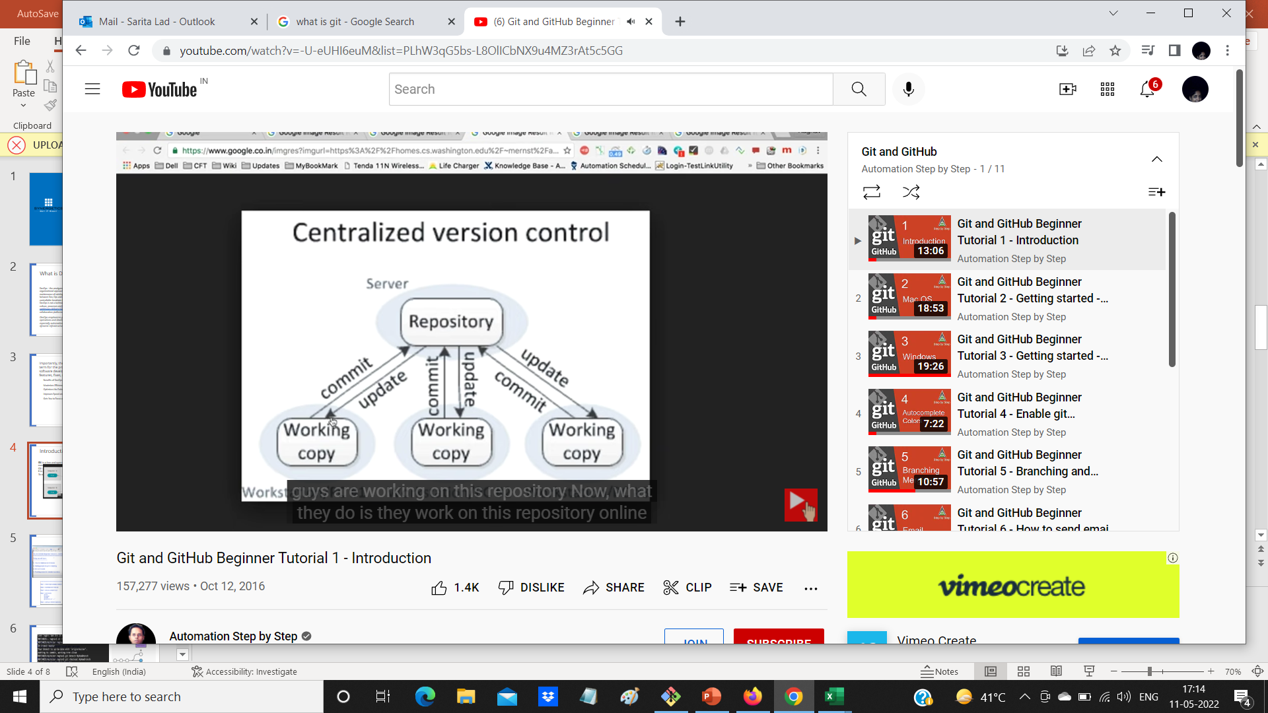
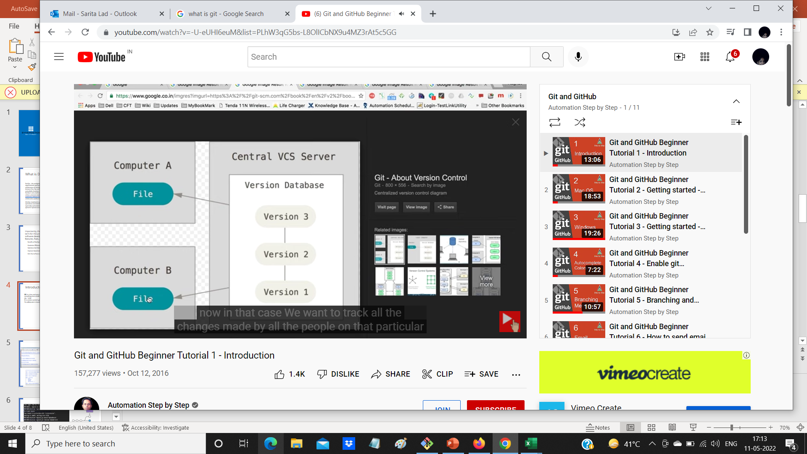
Introduction to git and github
Centralized Version Control System:
Disadvantage
1 Team members need to be continuously connected with this Centralized Repository
2 if something goes wrong in central repository , then it is a loss for all at once.

Slide 5
Today we will learn
1 What is GIT?
2 What is GitHUB?
3 Is GIT related to GITHUB ?
4 A simple workflow
GIT is a version control system
1 -to track changes in files/folders
2 - to collaborate in teams

Slide 6
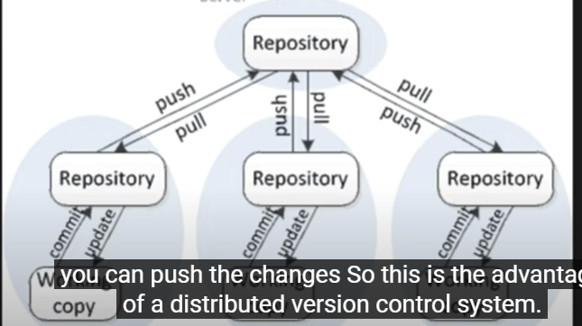
1 Git is Distributed Version Control System
Git is a free and open source distributed version control system designed to handle everything from small to very large projects with speed and efficiency.
Git – VCS
It is version control system : to track changes in files and folders,
To collaborate in teams
2 GITHUB is a website to upload your Repository online
Github provides
1 – backup of your work
2 – visual interface to your repository
3 – makes collaboration easier

Slide 7
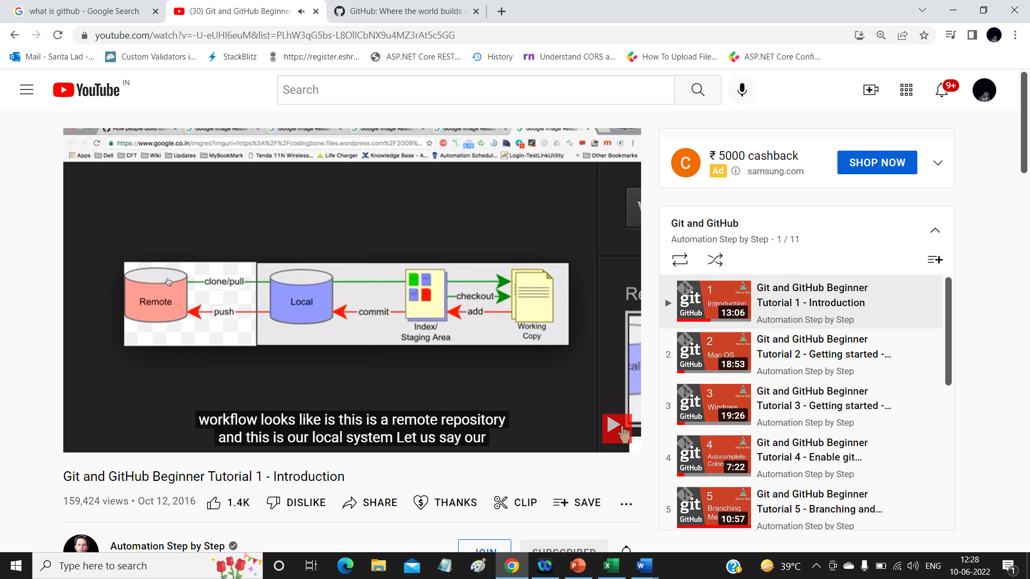
Is Git related to GitHub?
Git != GitHub
Let us see WorkFlow of git .

Slide 8
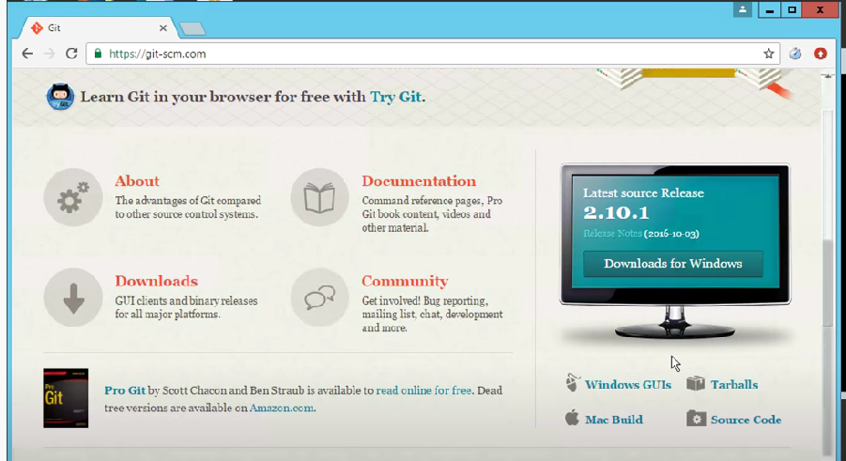
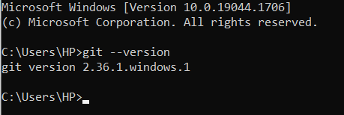
Workflow of working with git:
1 How to download git on windows
2 adding project to git for tracking
3 Git commands
4 Pushing project to remote repository

Slide 9
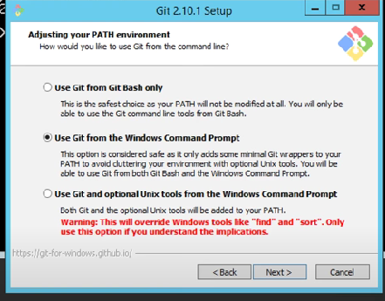
Steps to work on git
create a new repository on the command line
1 from command promp
in c:\desktop\ MyProject folder \>git init
2 git config --global user.email "saritalad@synergetics-india.com"
3 git config --global user.name "saritaAtSynergetics“
4 git status
5 git Add test1.txt/ git Add .
4 git commit –m “added test1.txt”
5 Adding to remote Repository
git remote add origin https://github.com/saritalad/synergeticsreposistory.git
6 git push –u origin master

Slide 10
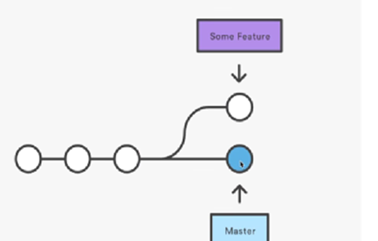
What are BRANCHES ?
How to create a branch
How to checkout branch
How to merge branch to master
How to delete branch local and remote
What are BRANCHES ?
Step 1 : git branch branchname
Step 2 : git checkout branchname
Step3 : add files ()
Step 4 : git add .
Step 5: git commit –m “new files added
Step 6 :git push –u origin branchname
We can see new branch added remotely

Slide 11
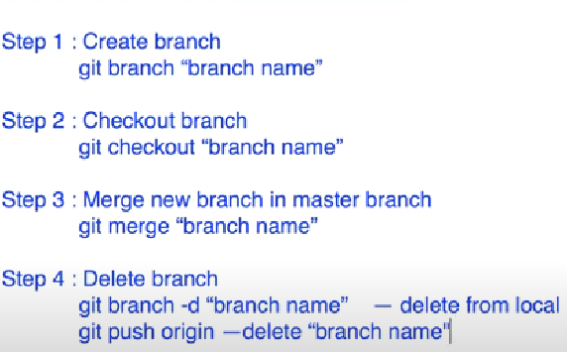
How to merge Branch?
1 git branch -d devops remove from local
2 git push origin --delete devops remove from remote
====================
To integrate remote repository with local:
git pull origin master

Slide 12
How to remove merge conflict Branch?
Create a 2 text files file1 and file2 in master branch
Add master contents in file-1
Create new branch b1
then update file1 with branch contents
after that merge branch into master
you get a conflict message
now resolve conflict
by opening file1 and which contents you want in that file master/branch
save the file
then do the merging of branch b1 to master
conflict removed/resolved.

Slide 13
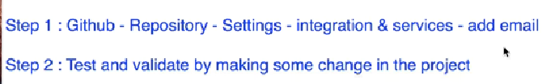
Notification email from github
Git clone https://github.com/saritalad/MKPITS_Akash_Narwade_DotNet_Sept_2021.git

Slide 14


Slide 15
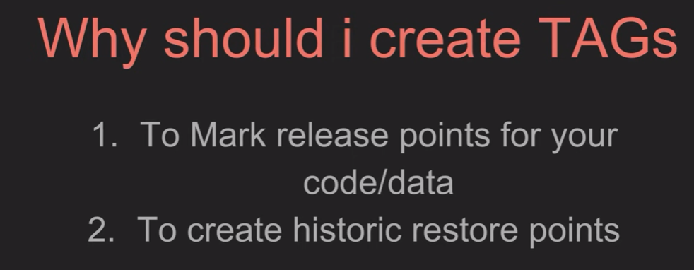

Slide 16
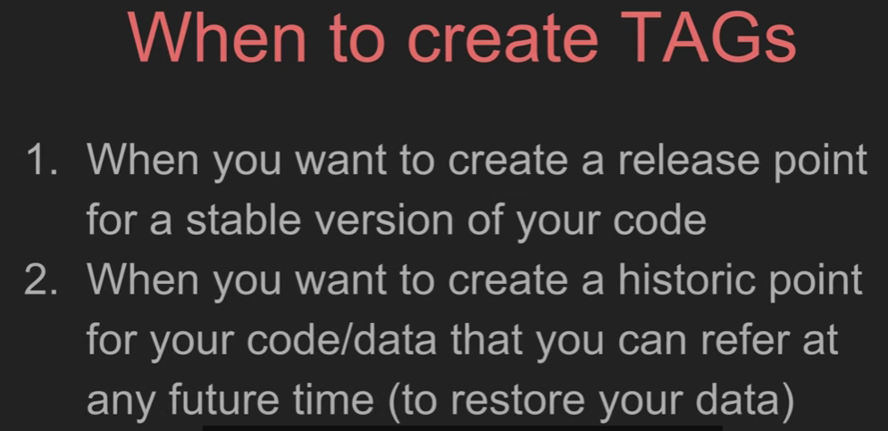

Slide 17
Git merge and got rebase
There are 2 ways 2 integrate changes from one branch to another .
Git merge
Git rebase
Git log to see history
============================
D:\> mkdir gitdemo1
D:\gitdemo1\> git init
Git remote origin …………………………………..
Git touch m1.txt (added and committed)

Slide 18
Git branch feature
Checkout feature
Touch f11.txt (added and committed)
Checkout master
Touch m2.txt (added and committed)
Checkout feature ( u will not see m2.txt only m1.txt and f11.txt) in this branch
Now
Inside feature apply
Git merge master (press escape :wq to come out of merge command)
Now u get ( m1.txt, f11.txt and m2.txt )
Git log
Create folder gitdemo2
Same steps (m1.txt , in feature f1.txt, in master m2.txt)
Checkout feature
Git rebase master
Git log will see all files m1.txt,m2.txt and f1.txt in feature branch

Slide 19
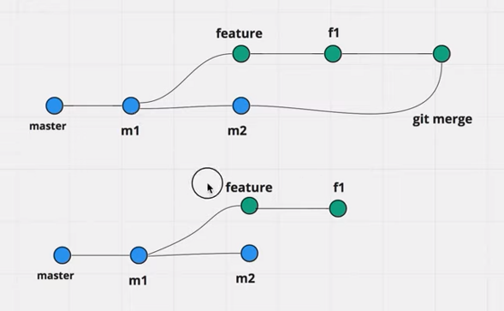
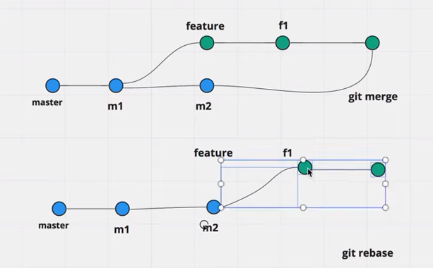
Difference between merge and rebase
Merge maintains the master merge history in git log but rebase does not show the merge history it
Simply shows the history of files from two branches (individual files)

Slide 20
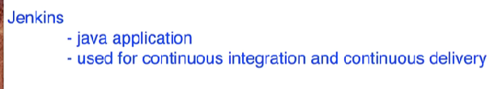
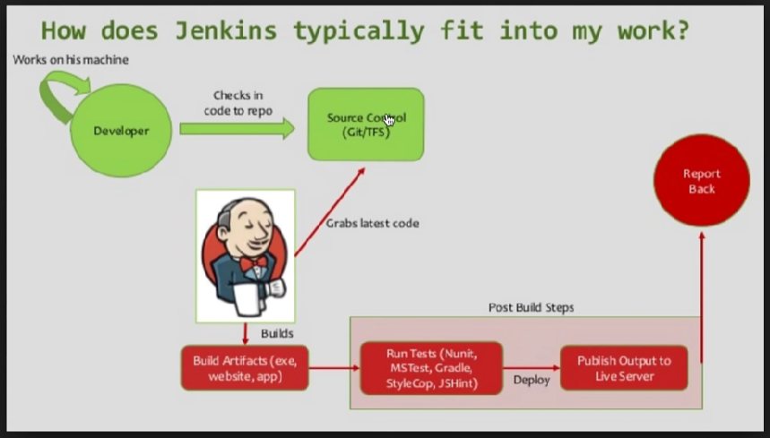

Slide 21
Jenkins:
Step 1 download Jenkins
Step 2 place war file into any location of your system
Step 3 goto that folder
C:\users\HP\> java –jar Jenkins.war
Step 4 : goto browser http://localhost:/8080
Step 5: install required plugins
Step 6: get started with Jenkins

Slide 22
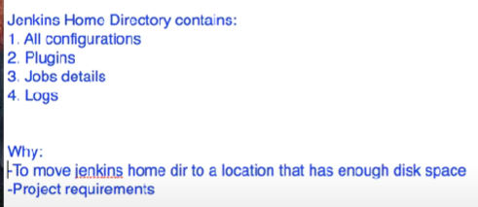
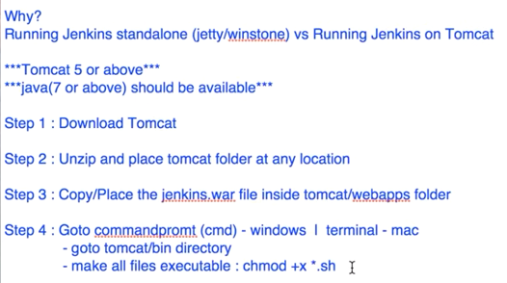
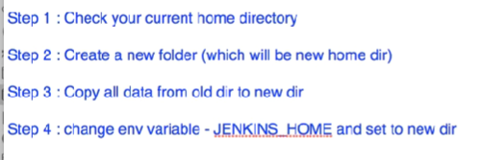
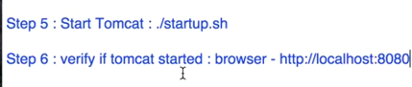
https://www.youtube.com/watch?v=Fi9pgrMlQZY&t=83s

Slide 23
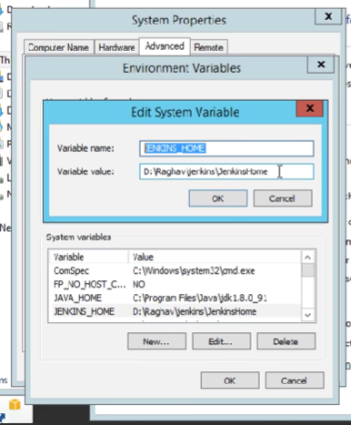
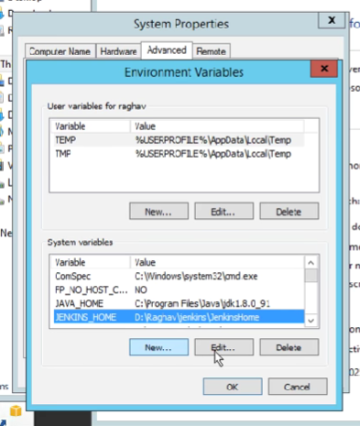

Slide 24
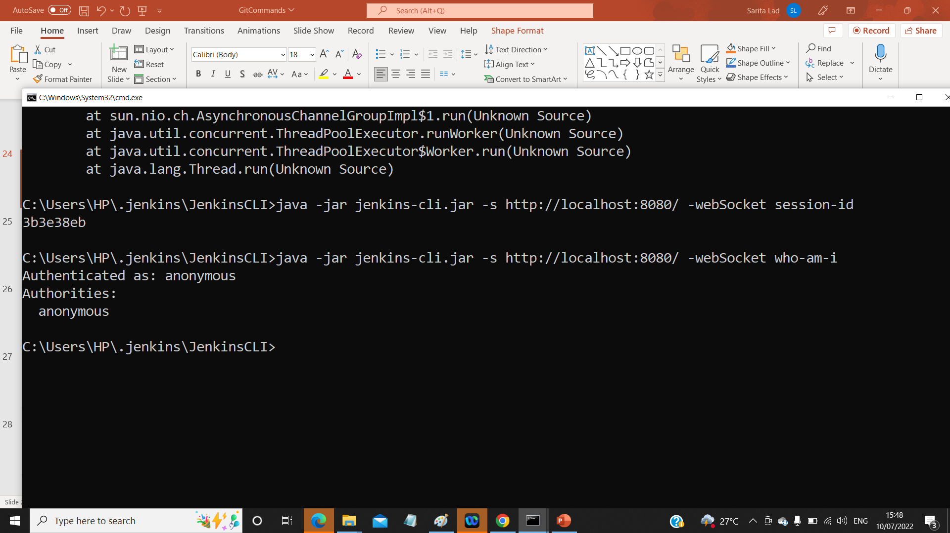
C:\users\HP> java-jar Jenkins.war –httpport =9090 to run on different port
User admin
Password admin
==================================
Why to use CLI tools?
Easier
Faster
Memory management efficient
Continuous Integration
==========================================
Step 1 :Start Jenkins:
Step 2:Goto manage Jenkins=>Configure global security ➔ enable security
Step 3:goto http://loclhost:8080/CLI YOU WILL GET LIST OF CLI COMMANDS
Step 4:download Jenkins-cli.jar place at any location see setting of global security seeting on next slide.
Step 5:java -jar jenkins-cli.jar -s http://localhost:8080/ -webSocket help
Step 6: ex:
java -jar jenkins-cli.jar -s http://localhost:8080/ -webSocket who-am-i

Slide 26
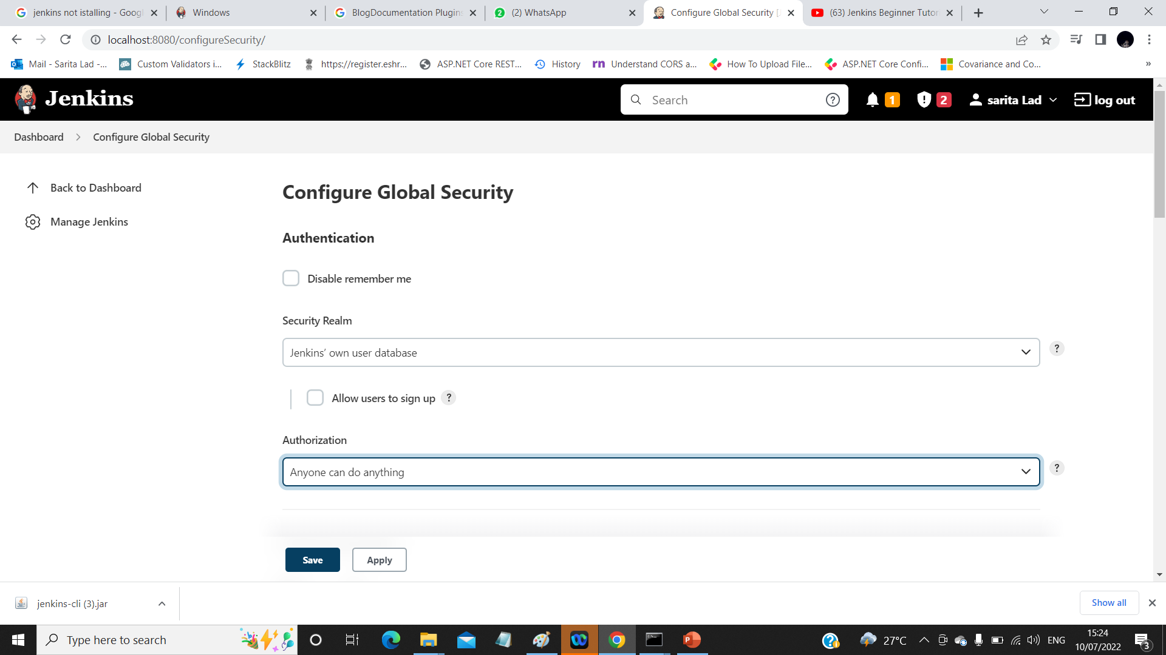




Slide 27
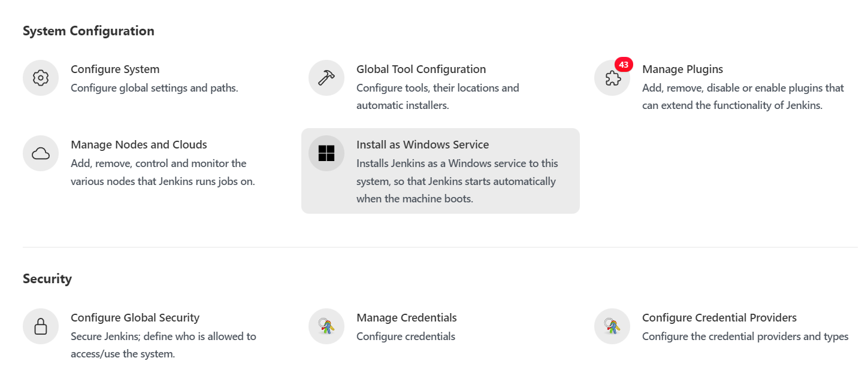



Slide 28
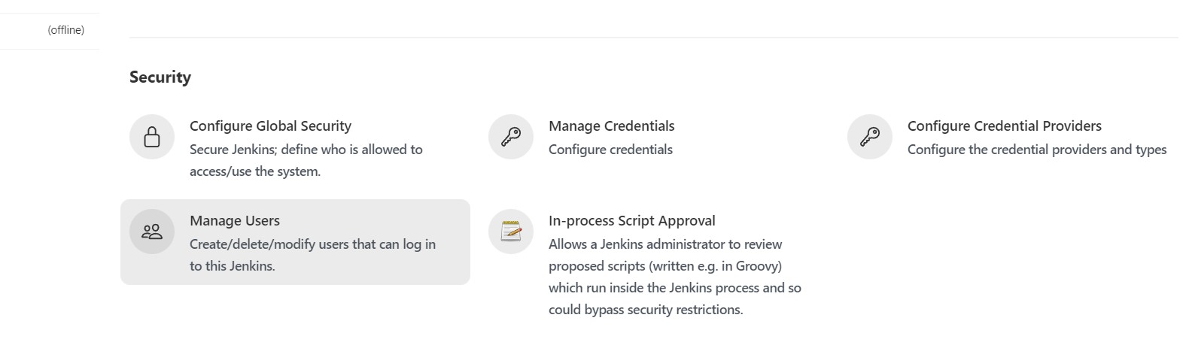









How to create Users + Manage + Assign Roles
Step 1: Create New User
Step 2 :Configure User
Step 3: Create and manage user Roles
Step 4: Install Roles Strategy PlugIn + download +
Restart Jenkins
Manage Jenkins Configure Global Security =>
Authorization => Rale based Strategy

Slide 29
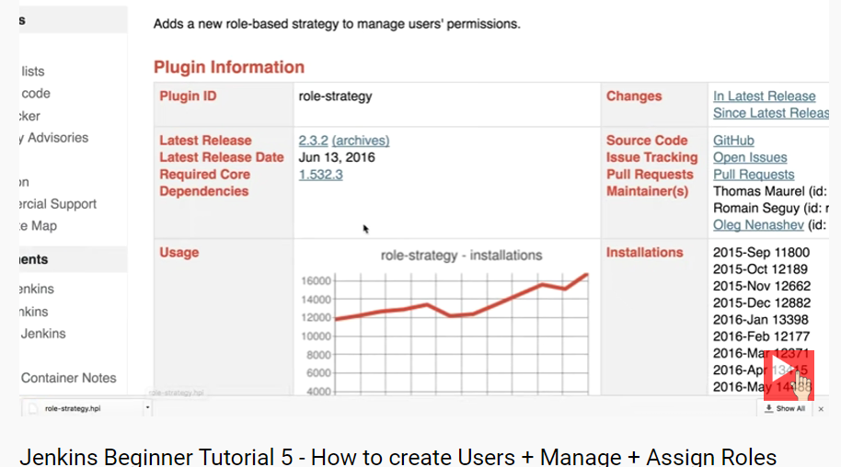



Slide 30
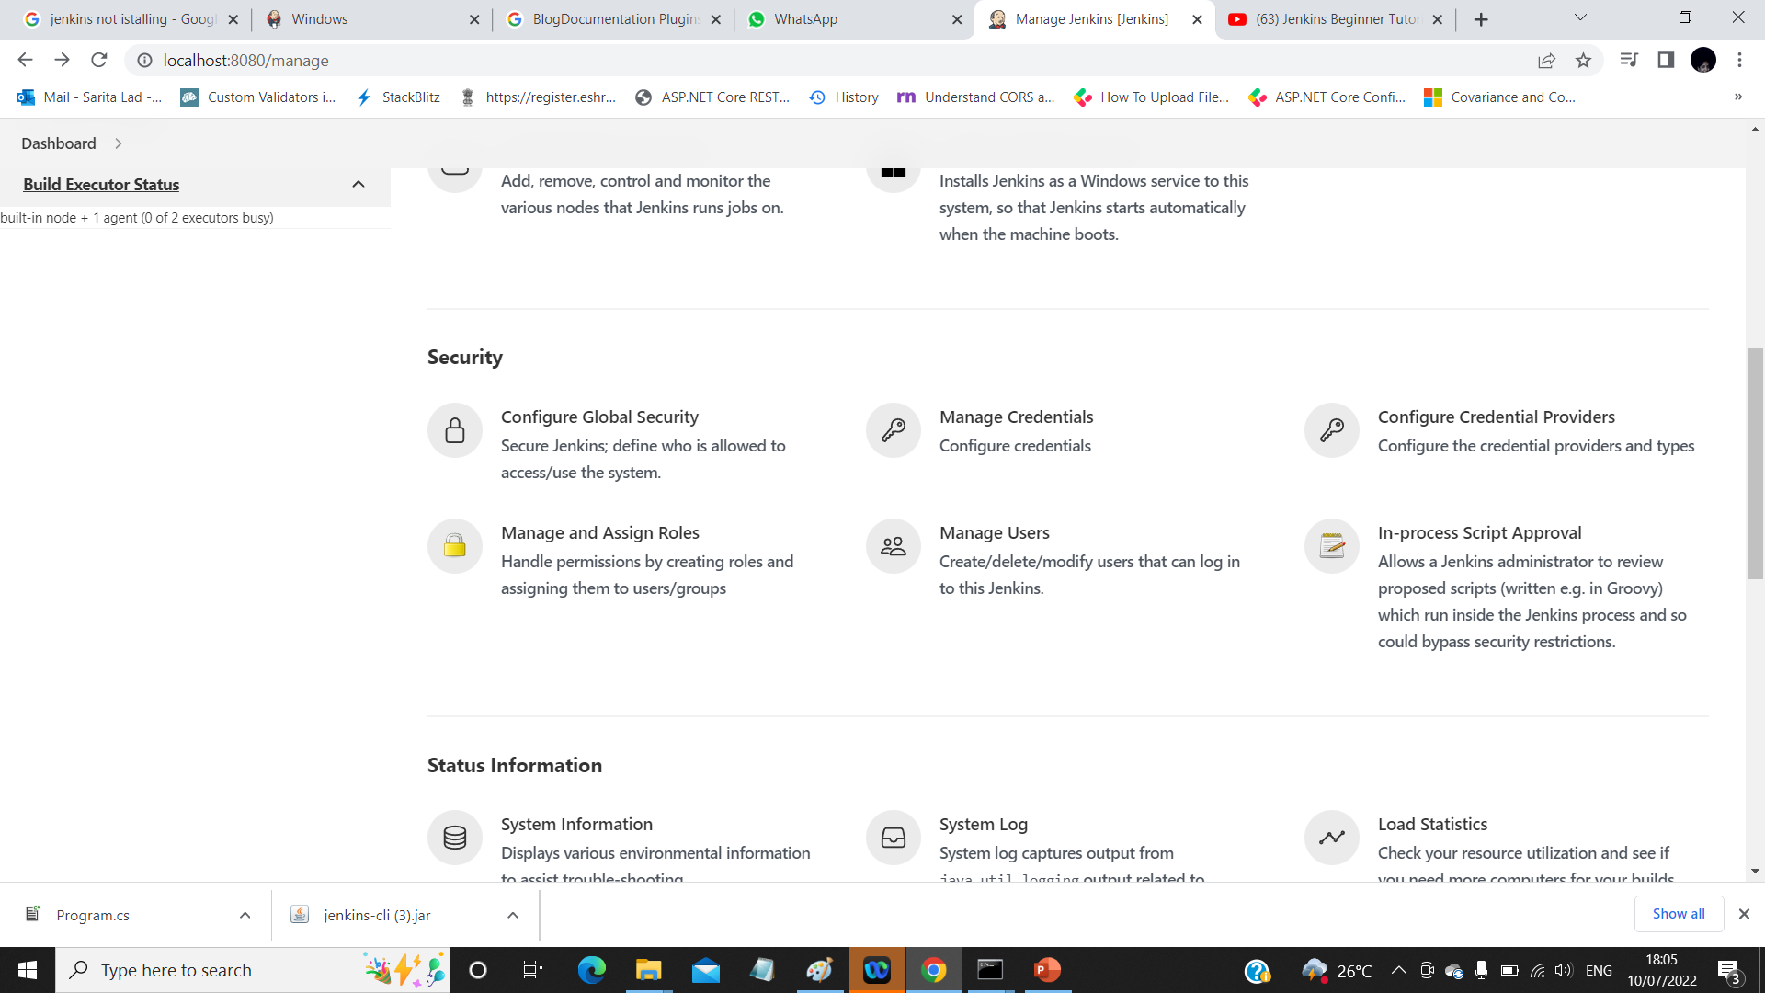
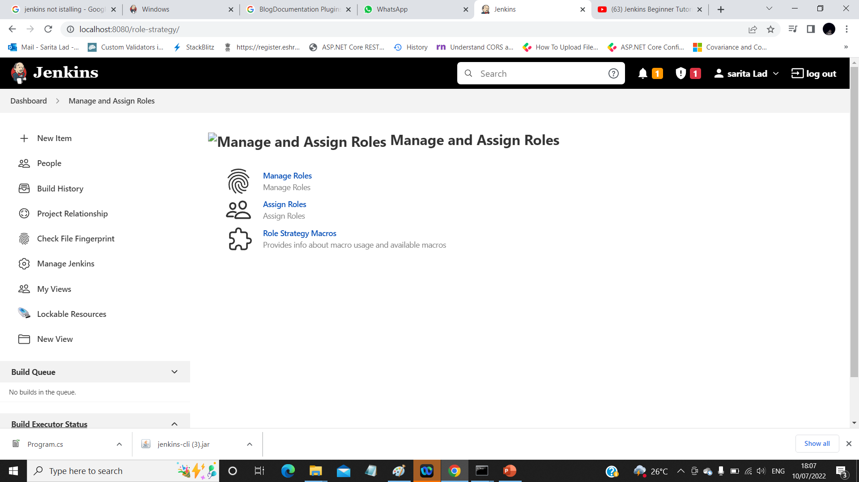

echo %date%
Dir
This menu is available only after install and select Role based Authorization is
Selected in Configure Global Security :
D

Slide 31
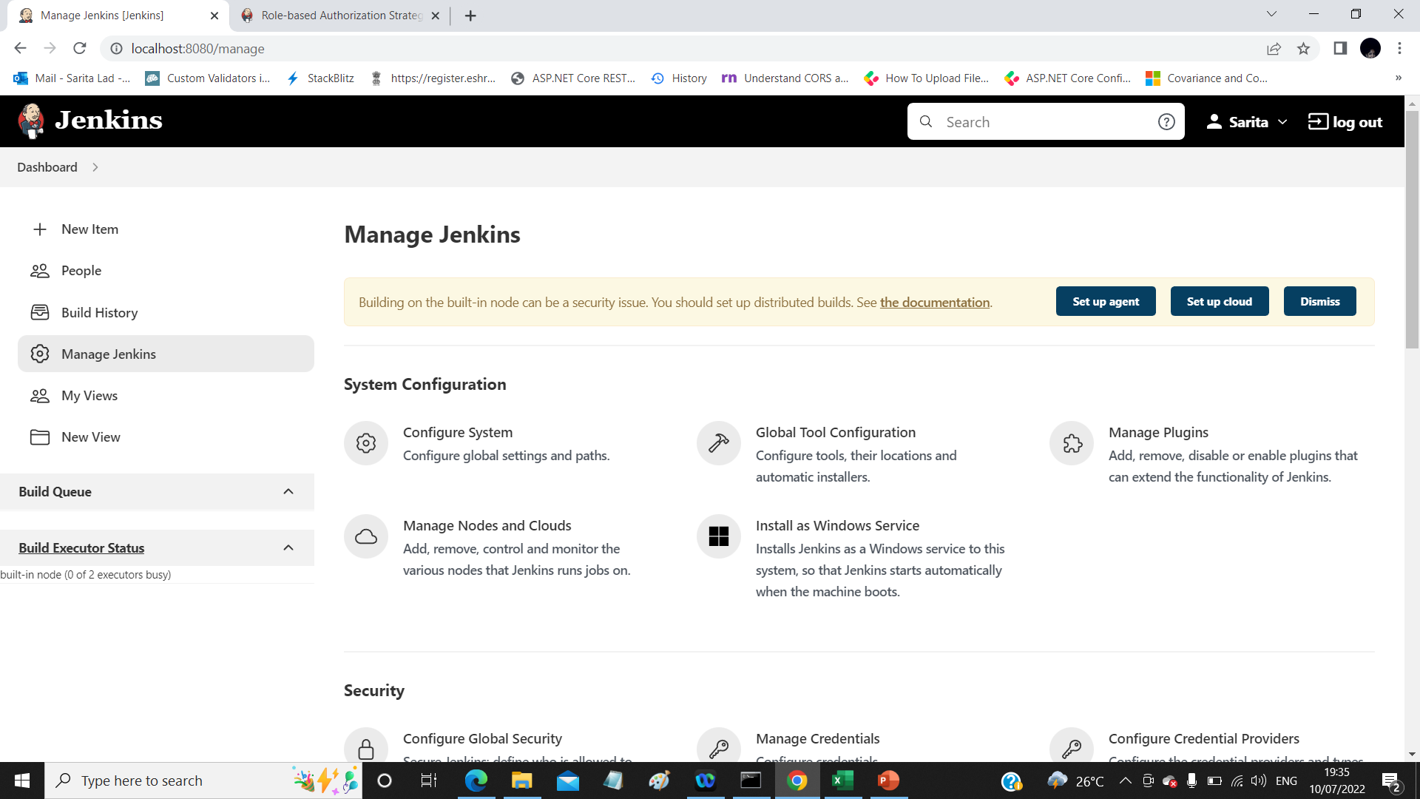
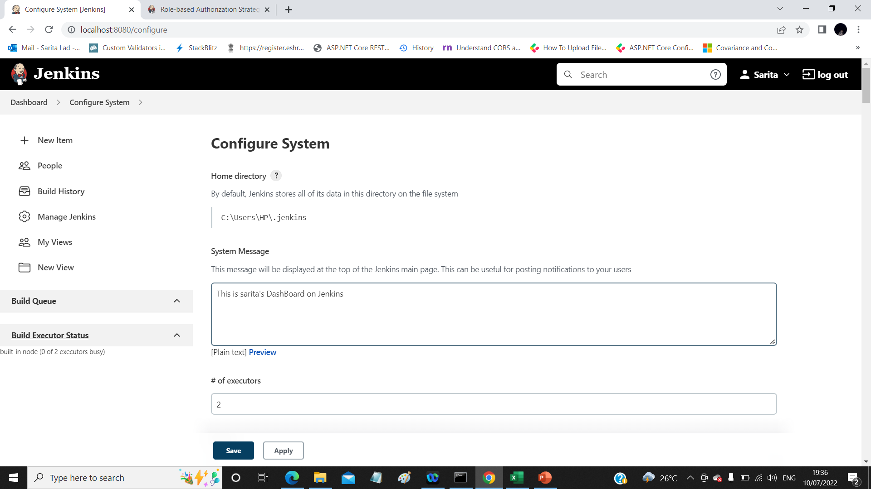

Slide 32
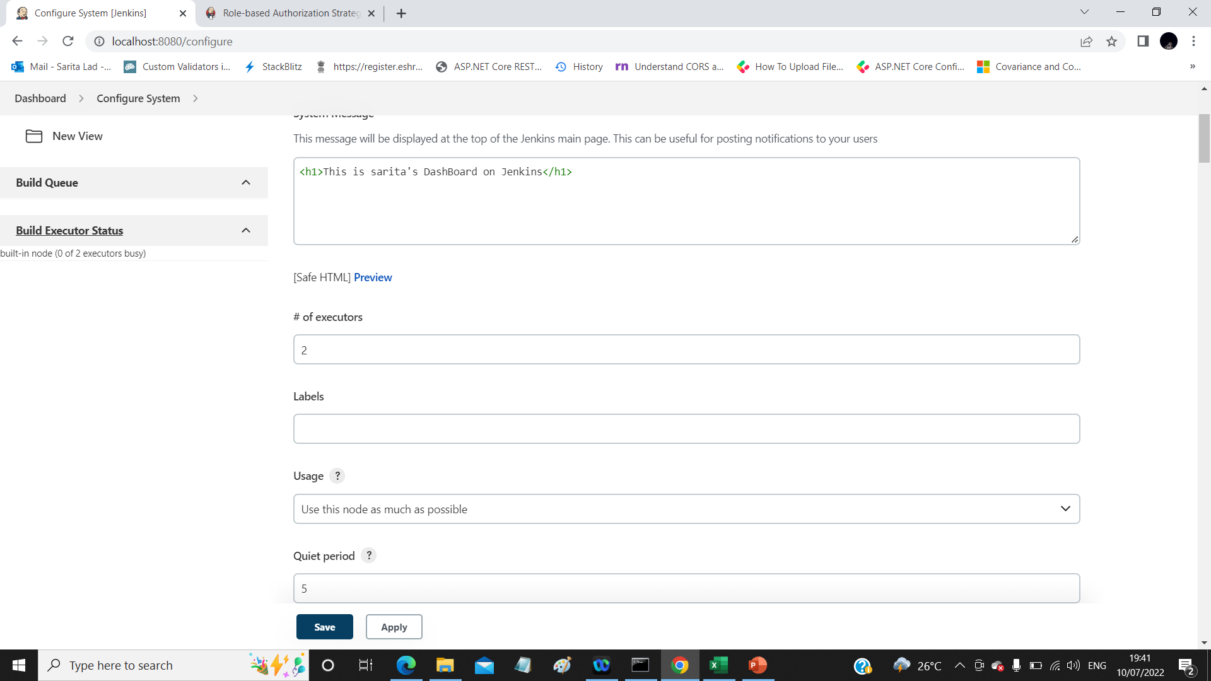

Number of parallel jobs at a time can run is 2

Slide 33
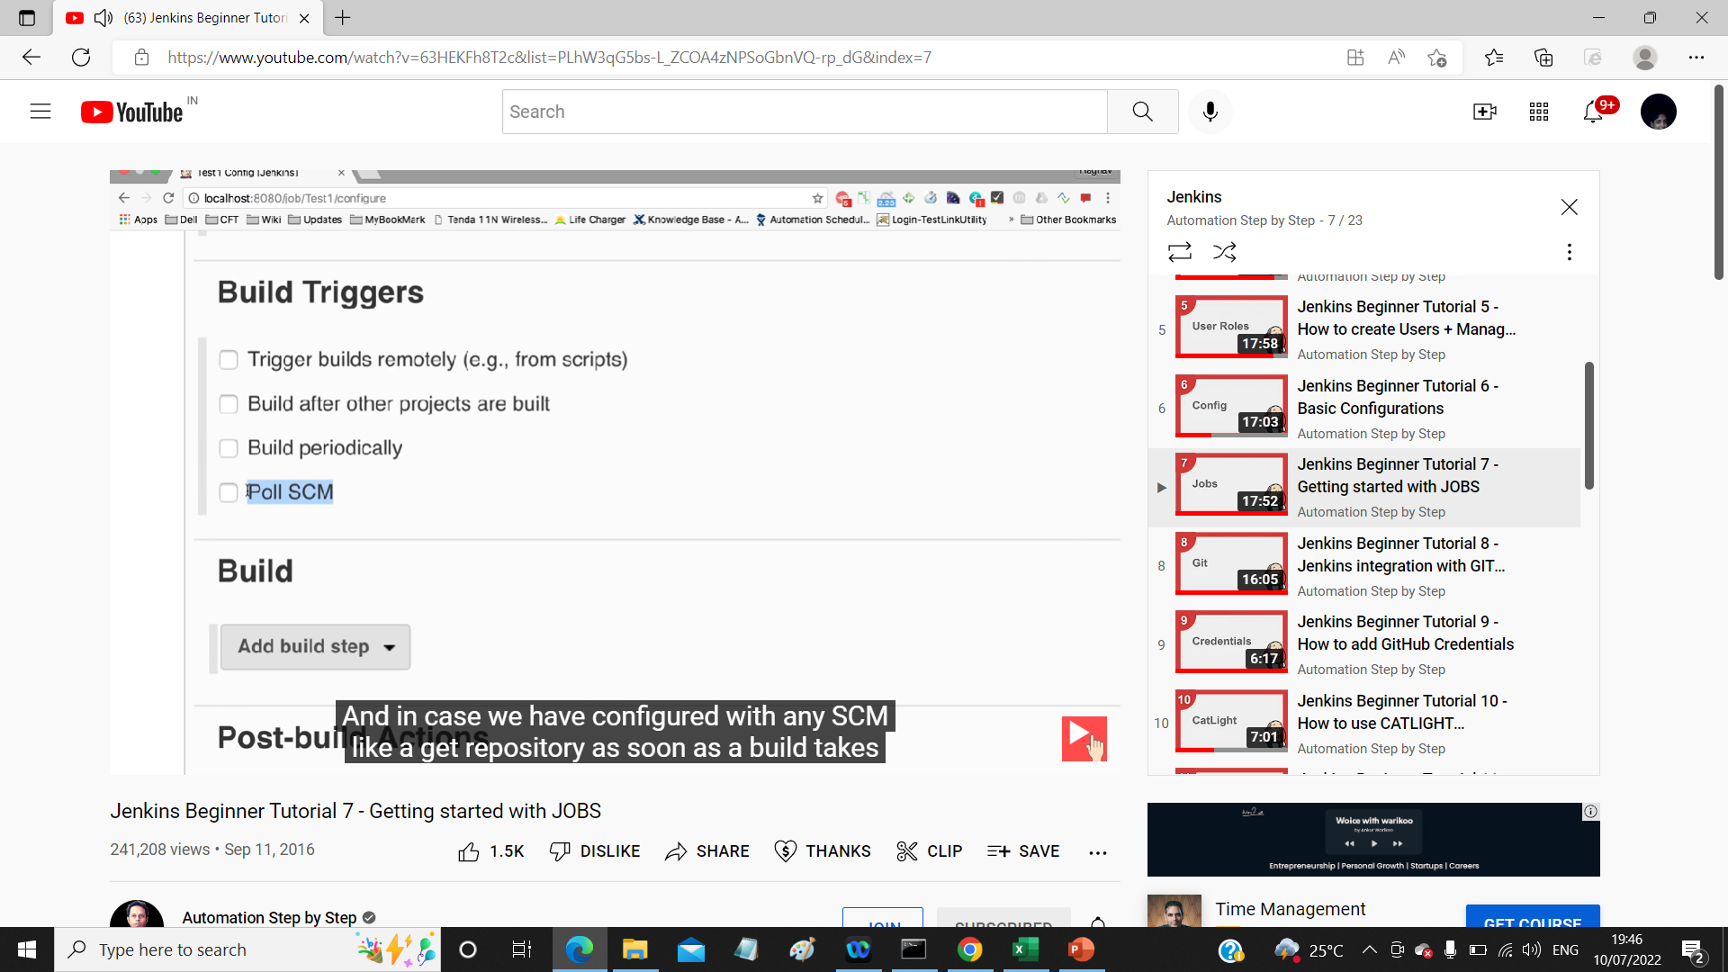
How to Create a basic job
Basic job configuration
How to run the job remotely
How to chain job Execution
Trigger remotely :
http://localhost:8080//job/consoleapp2/build?token=1234

Slide 34
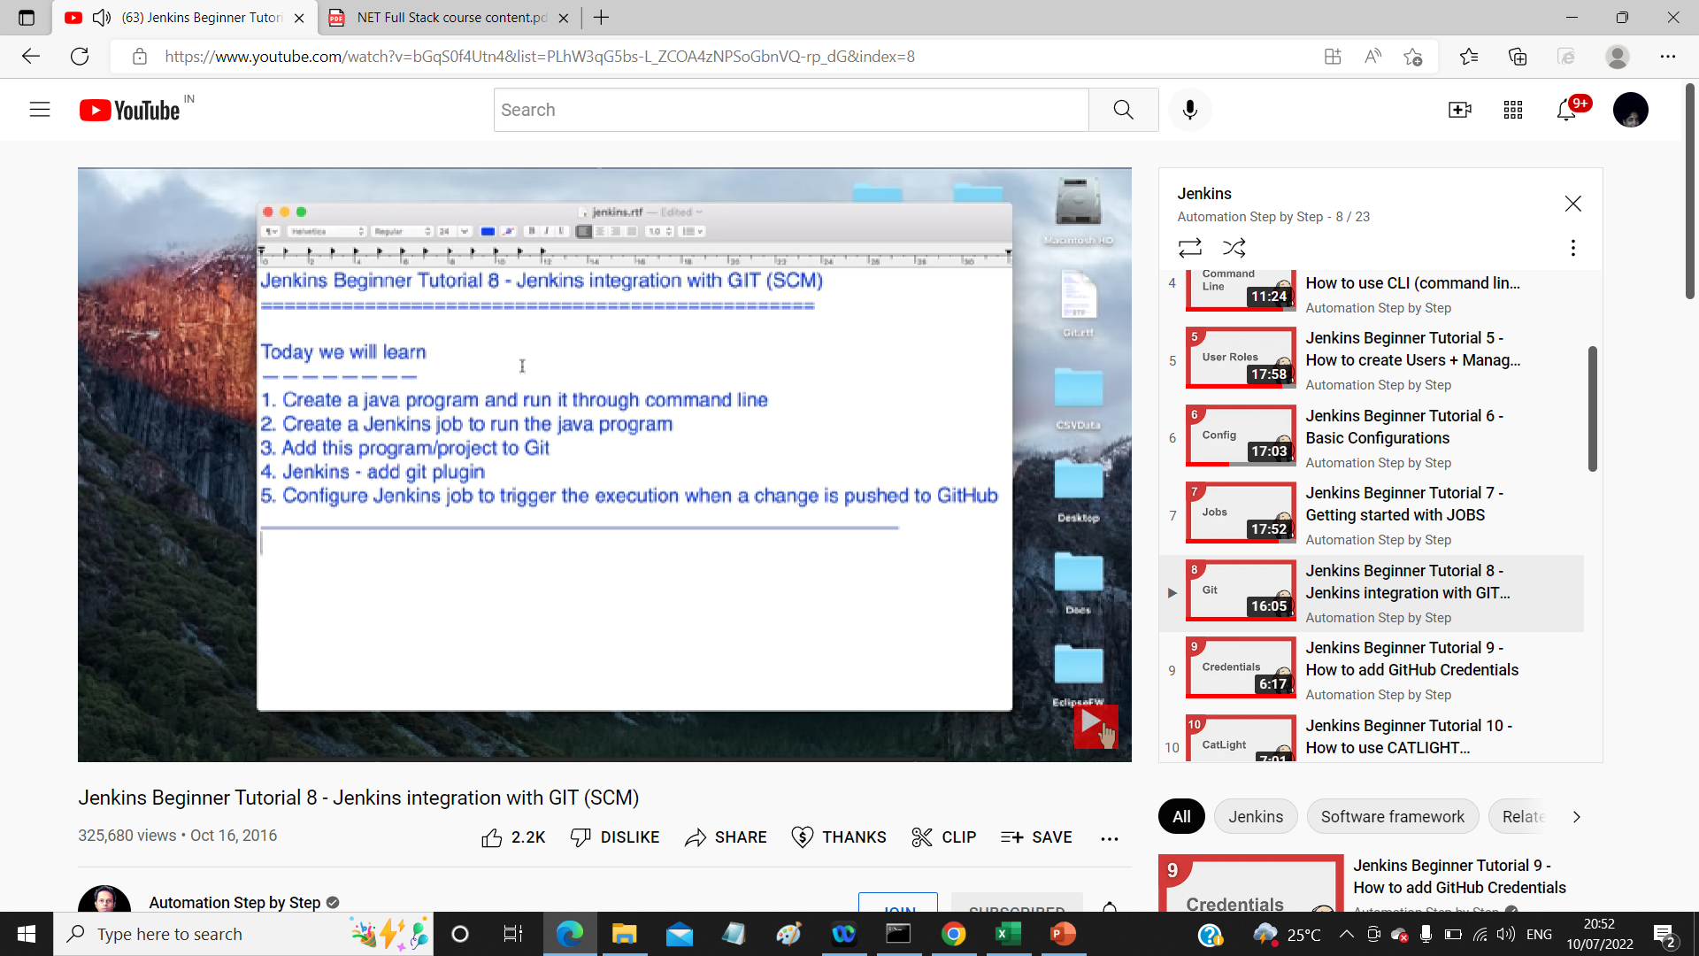

Slide 35
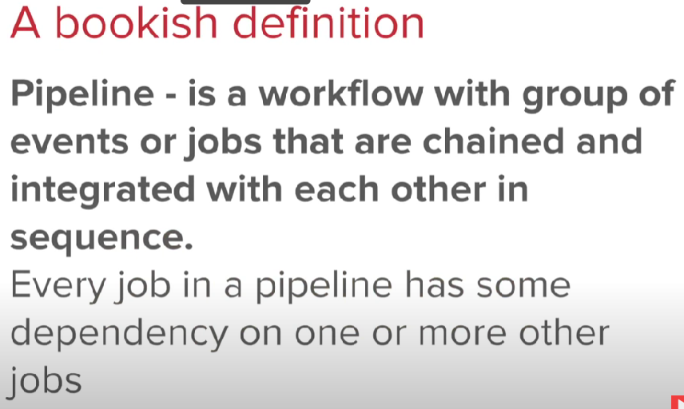
Jenkins Pipeline

Slide 36
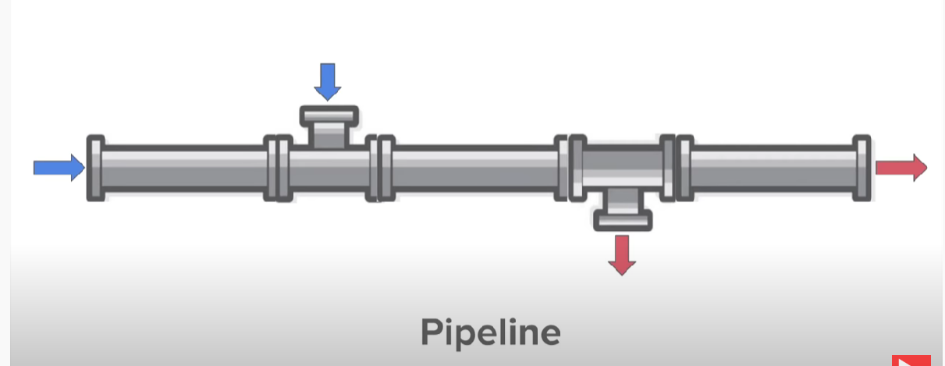

Slide 37
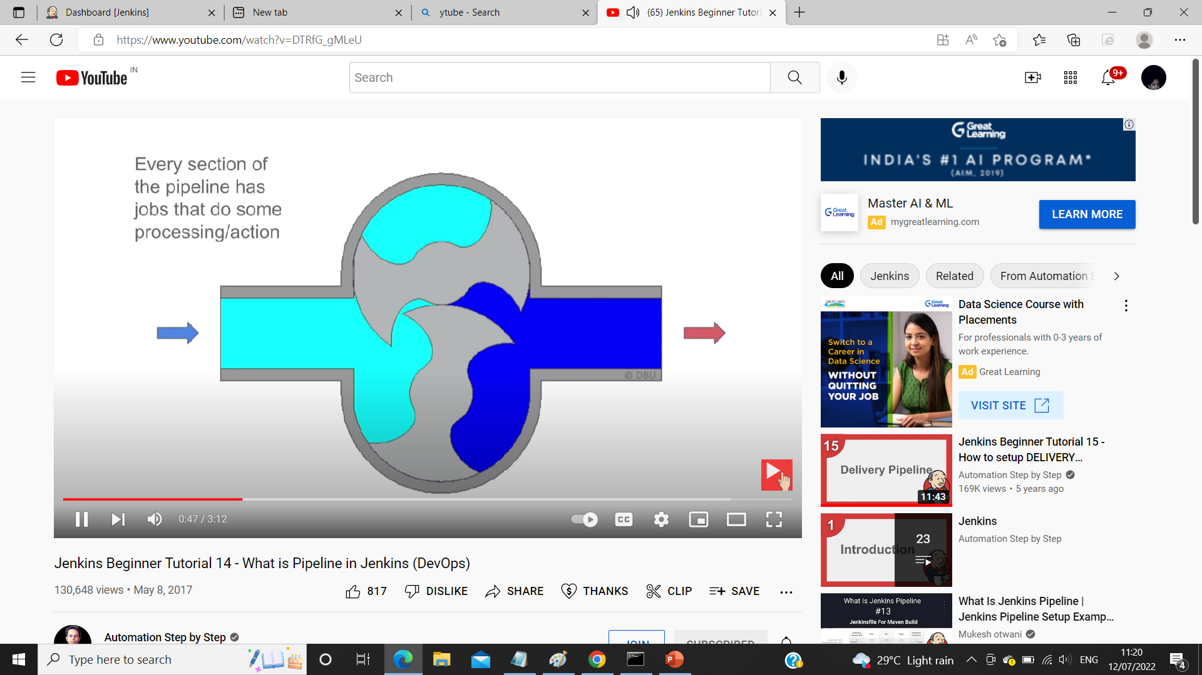

Slide 38
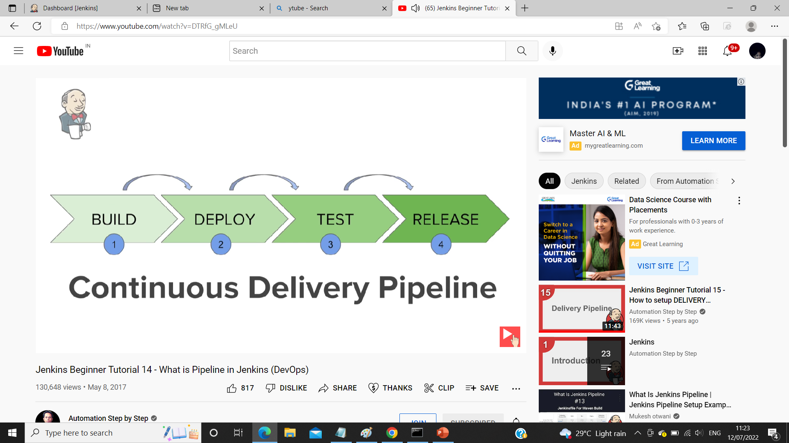

Slide 39
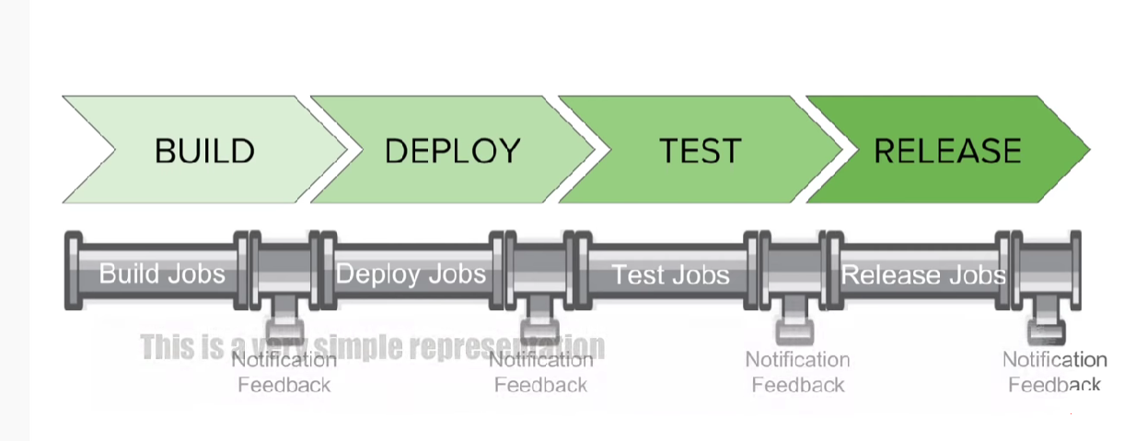

Slide 40
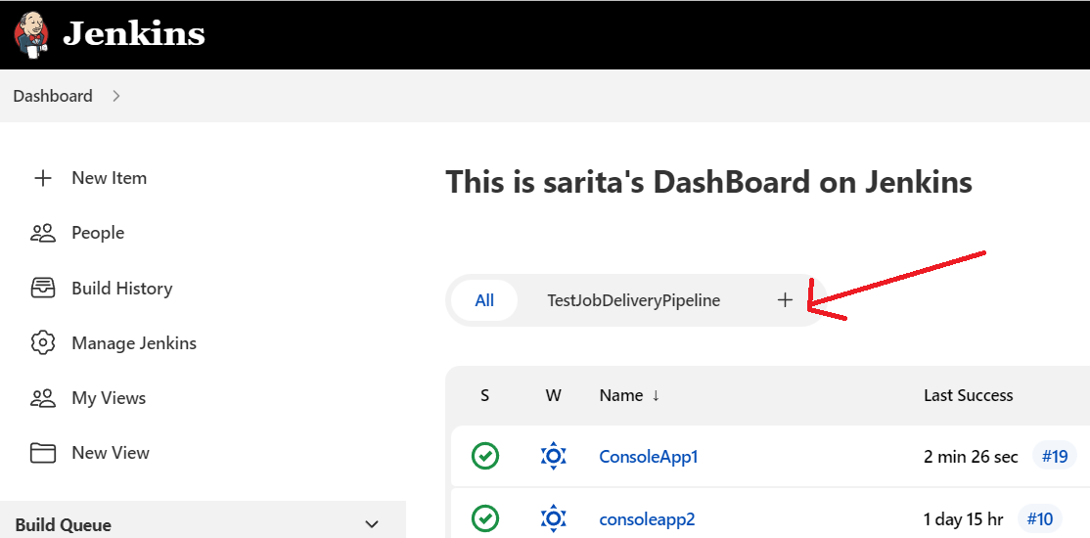
Setup Delivery Pipe Line
Step 1 :Create Sample Jobs=>SampleBuildjob,SampleDeployejob,SampleTestjob
Step 2: chain them using Build Trigger in SampleDeployjob and SampleTestjob
Step 3: install Delivery Pipeline => Manage Jenkins=>Manage Plugins => Available tab
Step 4 :Install Delivery Pipeline ( or google search and install ) Restart machine
Step 5: Start Jenkins and on DashBoard Click Plus + sign on top

Slide 41
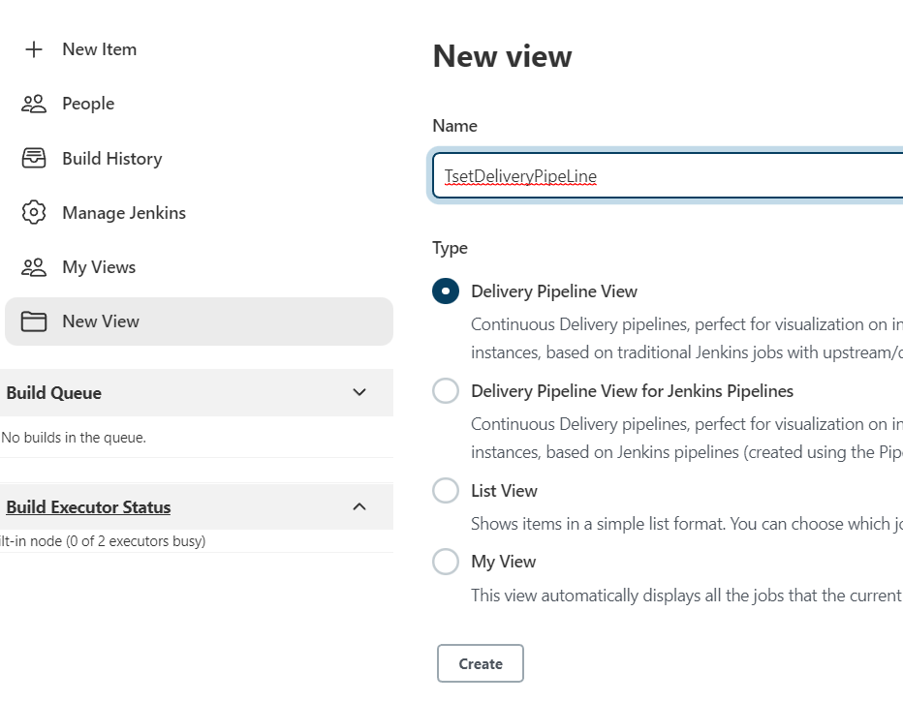

Slide 42
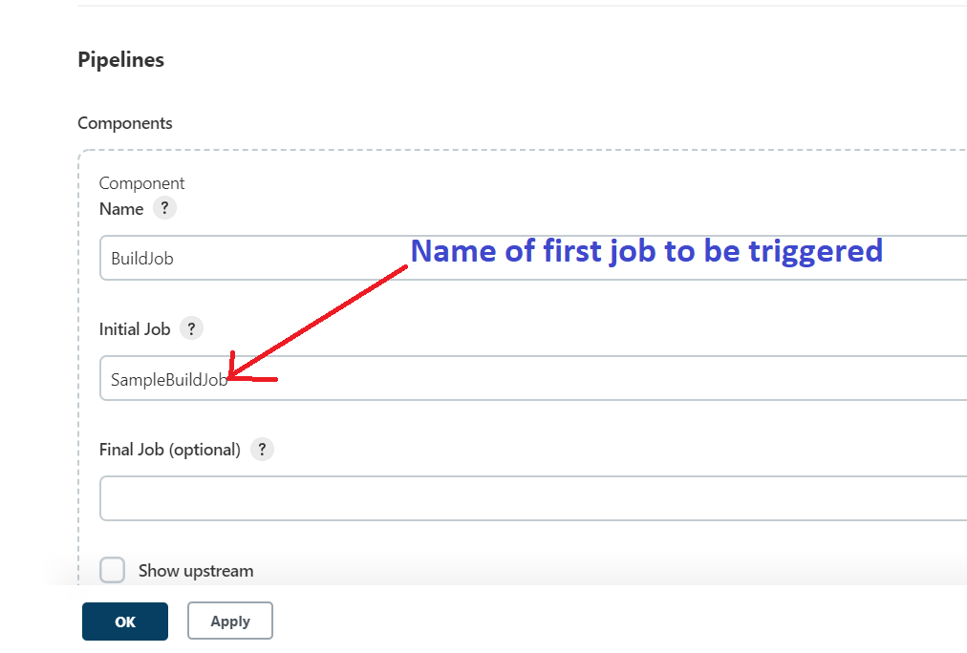
Component to be added in Delivery pipeline

Slide 43
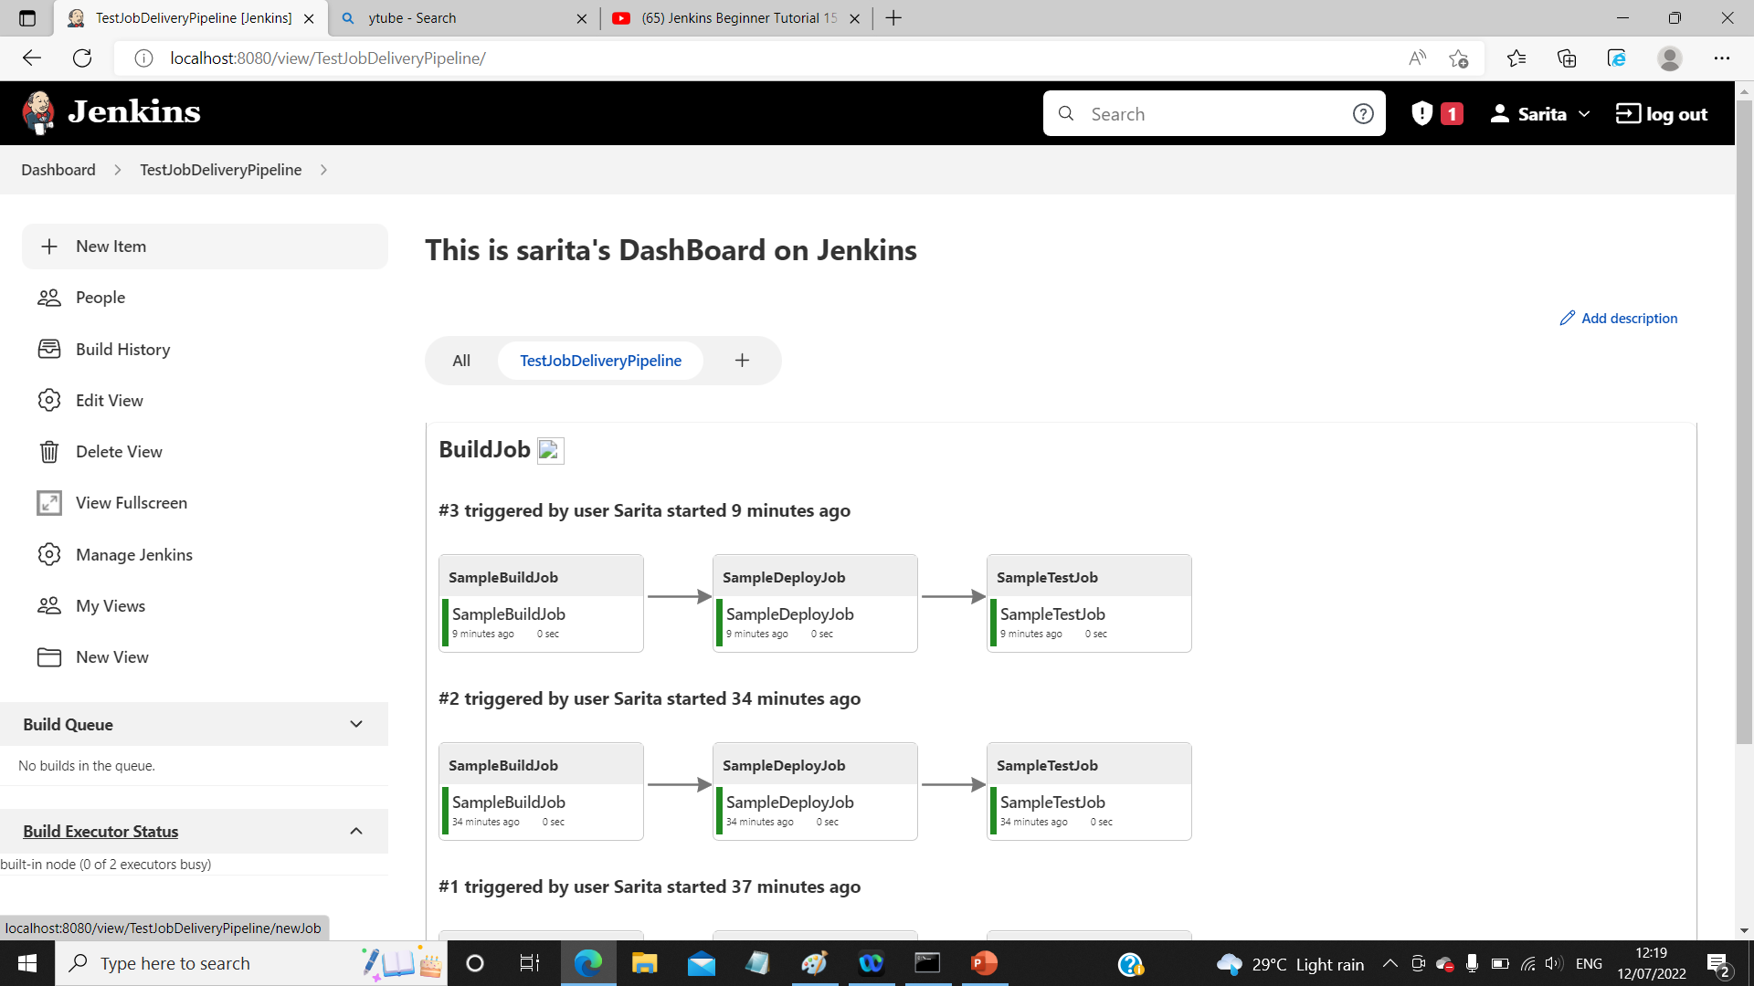


Slide 44
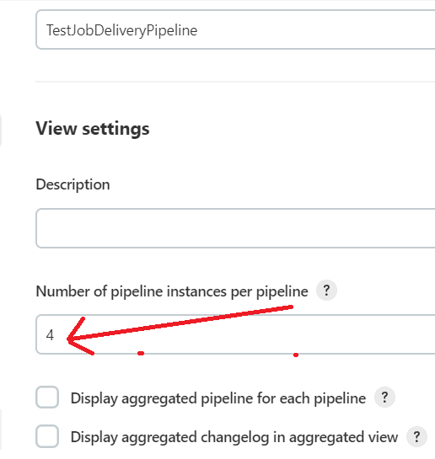
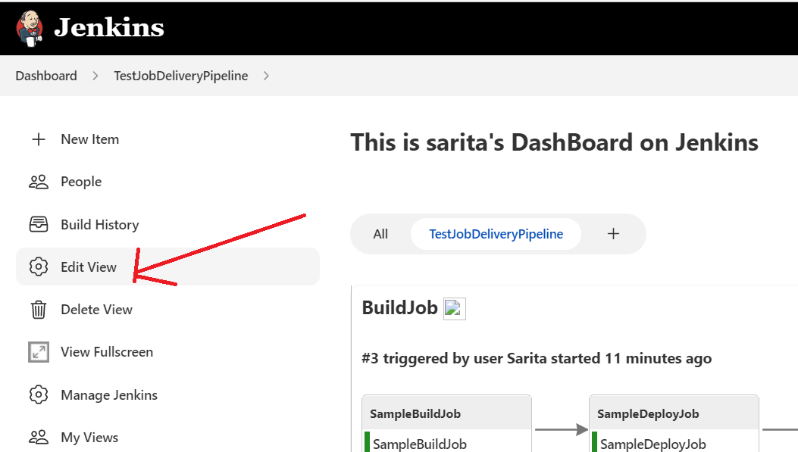
Edit Delivery PipeLine:

Slide 45
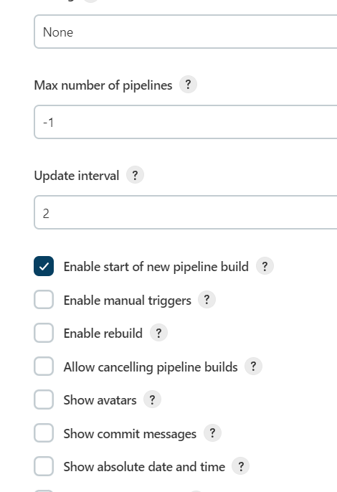
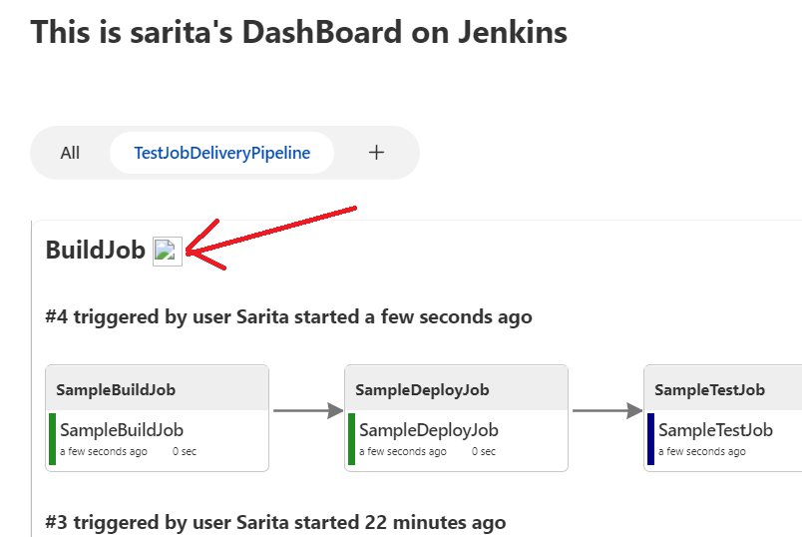
Edit View
Enable start of new pipeline build
Button is created

Slide 46
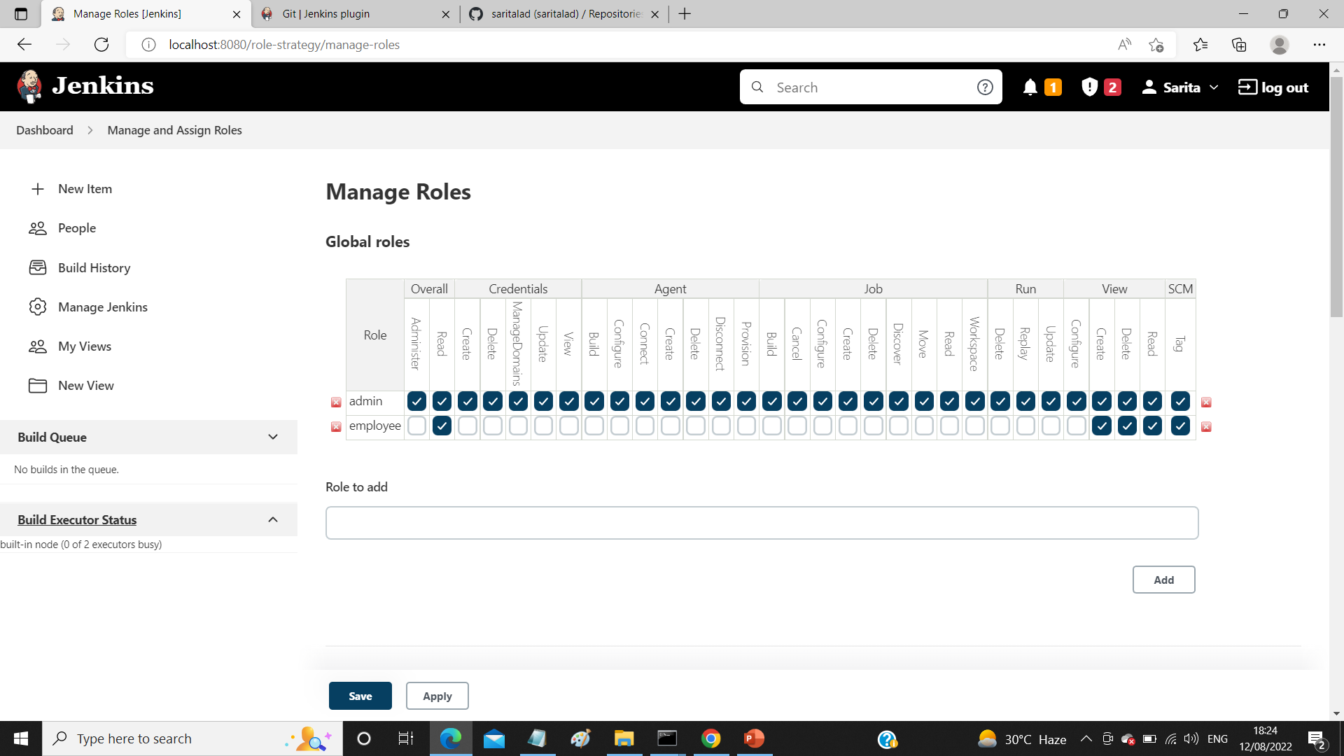
Manage Roles and Users

Slide 47
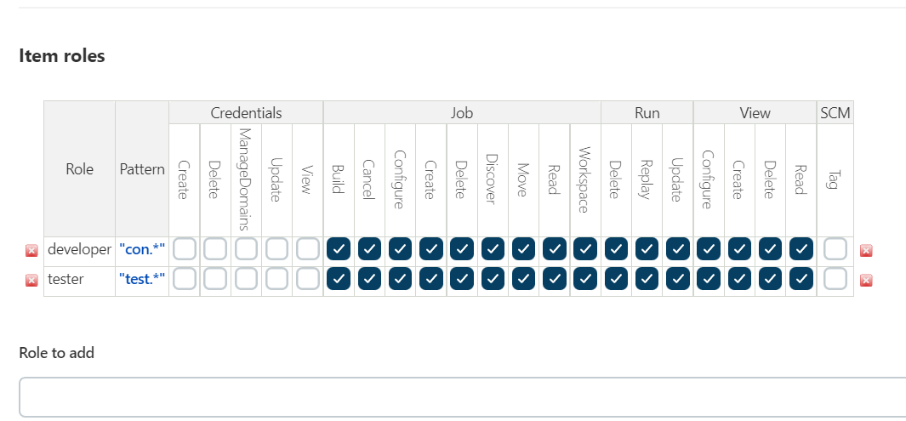

Slide 48
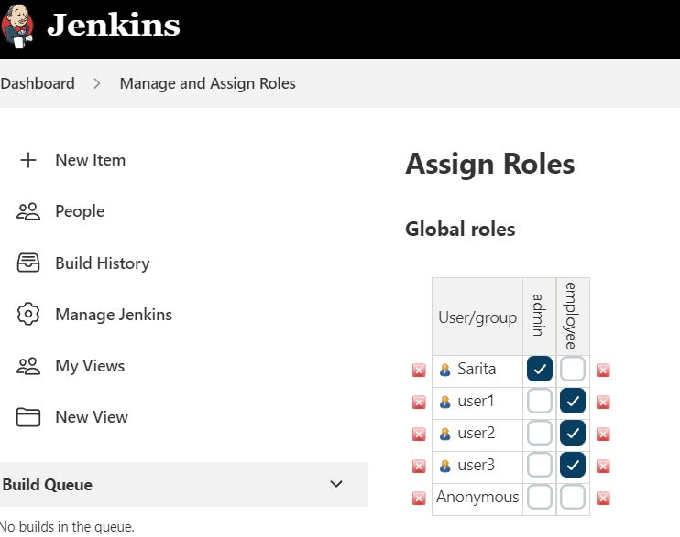

Slide 49


Slide 50
Thank You

